Slide 1
Software Products
Prof. Dr. Dirk Riehle
Friedrich-Alexander University Erlangen-Nürnberg
PROD B01
Licensed under CC BY 4.0 International
Notes:
It is Friedrich-Alexander University Erlangen-Nürnberg – FAU, in short.
Corporate identity wants us to say “Friedrich-Alexander University”.

Slide 2
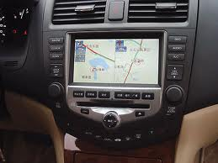
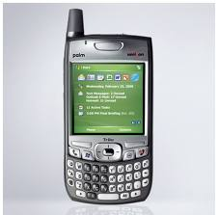


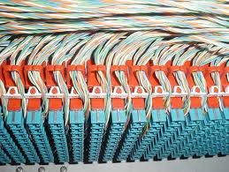
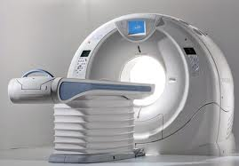
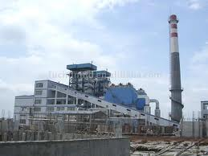
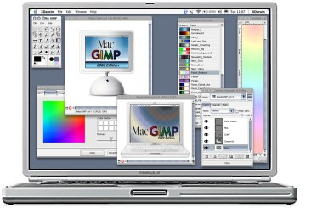
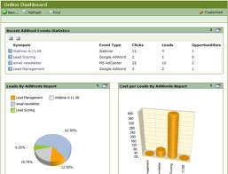


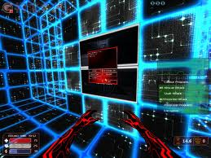

Slide 3
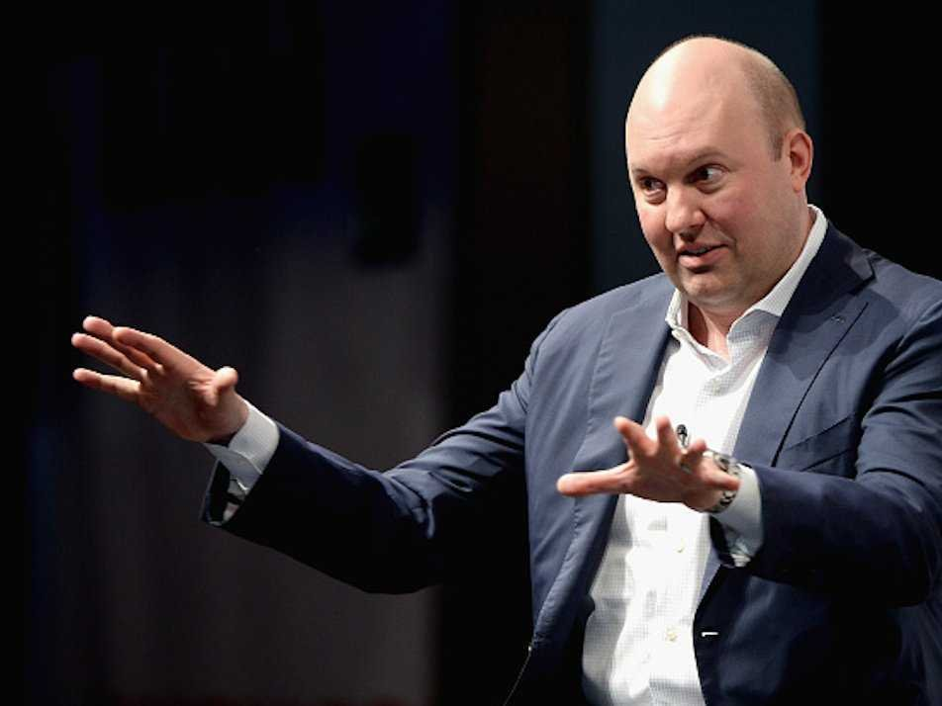
Software
is eating
the world
WSJ, 2011-08-20

Slide 4
Software as a Product
Product
  A man-made artifact sold to customers in a market
Software
  Has an open-ended life-cycle: Is born, may life forever
  Typically requires upfront capital investment (development)
  Is cheap and easy to reproduce perfectly
Software as a product
  A product sold to either enterprise or retail customers
  What is sold is typically a usage right plus services

Slide 5
Core, Basic, and Whole Product
Core product =
  Core software
Basic product = bundle of
  Software + complementary materials + self-help services
  Guarantees about fitness for use + indemnification
  Support services
Whole product = basic product +
  Training
  Consulting
  Operations

Slide 6
Enterprise vs. Retail Customers 1 / 2
Enterprise customers (B2B)
  Are willing to trade money for time
Retail customers (B2C)
  Are willing to trade time for money

Slide 7
Enterprise vs. Retail Customers 2 / 2
“Some people spend time to save money, some spend money to save time.” [M10]

Slide 8
Software Products, Projects, and Services
Software products are provided by a software vendor
  Commercial off-the-shelf software (COTS) (“Standardsoftware”)
Software products can be operated by service providers
  Service providers specialize in specific products
Software projects are performed by consulting firms
  Custom software (“Individualsoftware”)
Many companies do all of the above

Slide 9
Software Projects
Projects
  A process with a defined start and a defined end
Software projects
  Revenues correlate with performed labor
    Fixed price vs. actual labor
  Accounted for as revenue and expenses

Slide 10



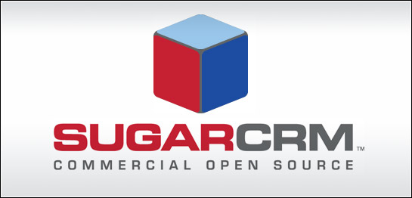





Software Products and Projects
Software
Vendor
Product
Consulting
Firm
Project
Widget Corp.
BI Impl. 2008
German SME
Sugar 2010
Continental
Stages 2010

Slide 11
Software Product Revenue
one-time license sale
revenue
initial
one-time
license fee
annual maintenance fee (~20% of initial fee)
1
2
3
4
5
time

Slide 12
Accumulating Traditional Software Product Revenue
one license sale per year
revenue
1
2
3
4
5
time

Slide 13
Accumulating Software Subscription Revenue
one license sale per year
revenue
1
2
3
4
5
time

Slide 14
Software Product vs. Project Revenue
Product Revenue
Project Revenue
one license sale
one project sale
revenue
revenue
1
2
3
4
time
5
1
2
3
4
5
time
one license sale / year
one project sale / year
revenue
revenue
1
2
3
4
time
5
1
2
3
4
5
time

Slide 15
Software Product vs. Project Companies
Consulting Firms
(Custom Development)
Software Vendors
(COTS Development)
Not capital intensive
Can be started easily
Stable maintenance revenue
High market capitalization
Advantages
Somewhat fragile revenue
Little long-term stability
High business volatility
Limited scalability
Hard to get started
Requires upfront investment
May be slow to react
Most fail, few survive
Disadvantages

Slide 16
Whole product
Basic product
Usage rights
Software (core product)
Core software
Additional software (extensions + plug-
ins, tools and utiltiies, integrations)
Complementary materials
Documentation
Training materials
Self-help services
Forums, mailing lists
Help and chat agents
On-line tutorials
Pricing of usage rights
Quantity: User, machine, time, …
Duration: Perpetual, time-limited, …
Structured: Initial license fee, regular maintenance fee
Guarantees (“insurance”)
Fitness for use, certification
Indemnification
Support services
Hot-line support
On-site servicing
Pricing of guarantees
By damage: Loss of business, fines received
Structured: Levels / bands, formula
Pricing of support services (SLAs)
By availability: Incident-based, 9x5, 24x7
By quality: First-level, second-level, third-level
Training
In-house training
Off-site training
Consulting
Technical implementation services
Strategic solution consulting
Operations
Provision of SaaS (managed service)
Pricing of training
Fixed fee
Per participating person
Pricing of consulting
Fixed fee
Time and materials
Pricing of operations
Quantity: Users, resources, …
Duration: Always time-limited
Structured: Set-up, subscription

Slide 17
Matching the Market
Bundling of product features
Addressing different markets
Utilizing different channels

Slide 18
Commercial Open Source Products [WR13]
Web Store
Direct Sales
DOC
documentation
INC
incident-based
support
Open
Source
Community
DOC
INC
UTIL
UTIL
utilities
LIC
commercial
license
Enterprise
Customers
LIC
UPD
UTIL
DOC
TRN
24x7
UPD
update service
TRN
training
ISV / OEM
LIC
UTIL
...
DOC
TRN
24x7
24x7
24x7 hotline

Slide 19
Review / Summary of Session
Software products
Core, basic, whole product
Products vs. projects

Slide 20
Thank you! Questions?
dirk.riehle@fau.de – http://osr.cs.fau.de
dirk@riehle.org – http://dirkriehle.com – @dirkriehle
DR

Slide 21
Credits and License
Original version
  © 2012-2019 Dirk Riehle, some rights reserved
  Licensed under Creative Commons Attribution 4.0 International License
Contributions
  ...

